Slide 1
Unit 4
Trees
Objectives
Upon completion you will be able to
Explain Basic Tree concepts.
Implement Binary search tree (BST)
Understand AVL trees
Data Structures: A Pseudocode Approach with C

Slide 2
In a non-linear list, each element can have more than one successor.
In a tree, an element can have only one predecessor.
In a graph, an element can have one or more predecessors.
Data Structures: A Pseudocode Approach with C

Slide 3
A Tree consists of a finite set of elements, called nodes, and a finite set of directed lines, called branches, that connect the nodes.
The number of branches associated with a node is the degree of the node.
When the branch is directed toward the node, it is an indegree branch
When the branch is directed away from the node, it is an outdegree branch.
The sum of the indegree and outdegree branches is the degree of the node.
Data Structures: A Pseudocode Approach with C

Slide 4
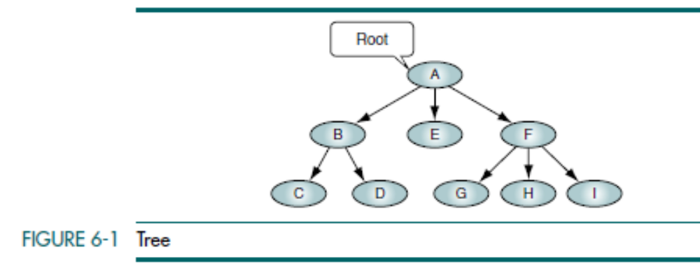
If the tree is not empty, the first node is called the root. The indegree of the root is zero.
Data Structures: A Pseudocode Approach with C

Slide 5
A leaf is any node with an outdegree of zero, that is, a node with no successors.
A node that is not a root or a leaf is known as an internal node.
A node is a parent if it has successor nodes—that is, if it has an outdegree greater than zero.
A node with a predecessor is a child. A child node has an indegree of one.
Two or more nodes with the same parent are siblings.
An ancestor is any node in the path from the root to the node.
A descendant is any node in the path below the parent node; that is, all nodes in the paths from a given node to a leaf are descendants of that node.
A path is a sequence of nodes in which each node is adjacent to the next one. Every node in the tree can be reached by following a unique path starting from the root.
The level of a node is its distance from the root. Because the root has a zero distance from itself, the root is at level 0.
Data Structures: A Pseudocode Approach with C

Slide 6
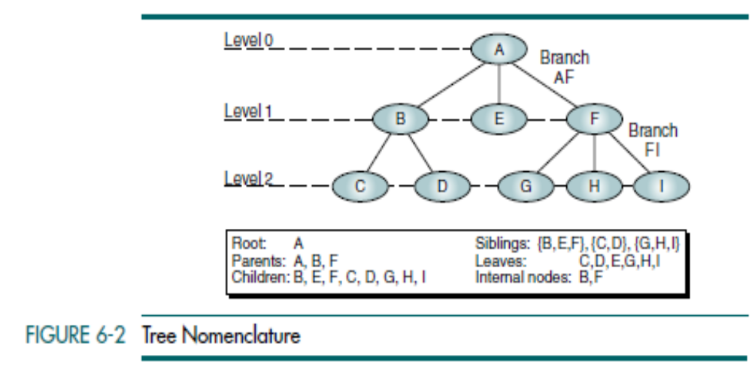
Data Structures: A Pseudocode Approach with C

Slide 7
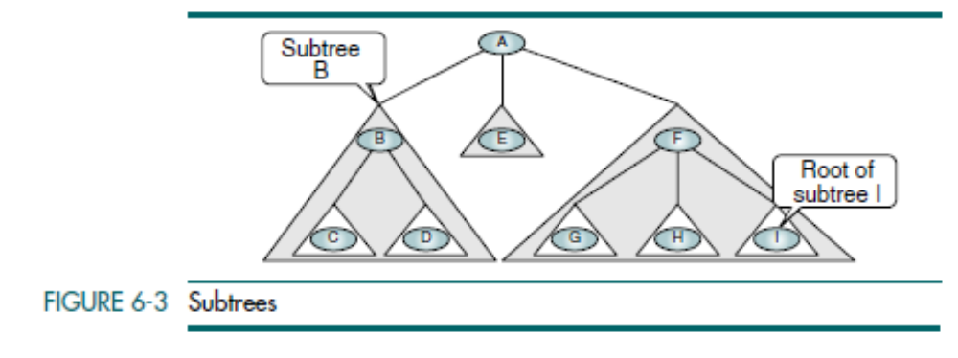

The height of the tree is the level of the leaf in the longest path from the root plus 1.
By definition the height of an empty tree is -1.
A tree may be divided into subtrees. A subtree is any connected structure below the root. The first node in a subtree is known as the root of the subtree and is used to name the subtree.
Subtrees can also be further subdivided into subtrees.
Data Structures: A Pseudocode Approach with C

Slide 8
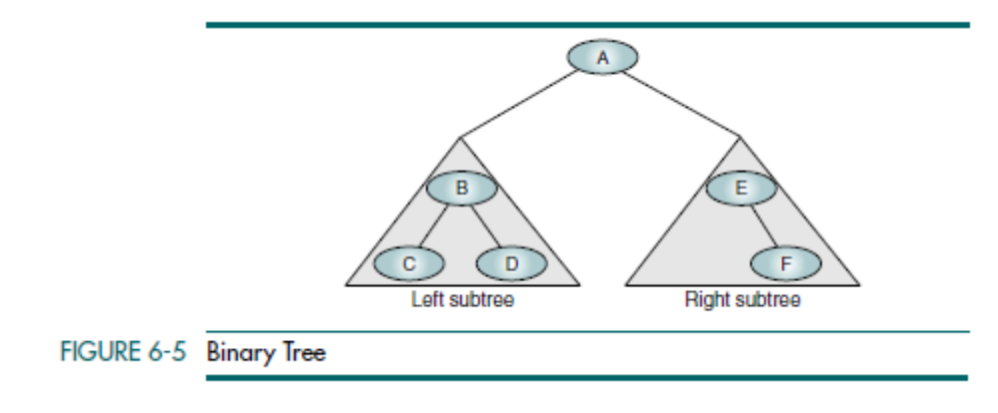
A Binary Tree is a tree in which no node can have more than two subtrees; the maximum outdegree for a node is two. In other words, a node can have zero, one, or two subtrees. These subtrees are designated as the left subtree and the right subtree.
Data Structures: A Pseudocode Approach with C

Slide 9
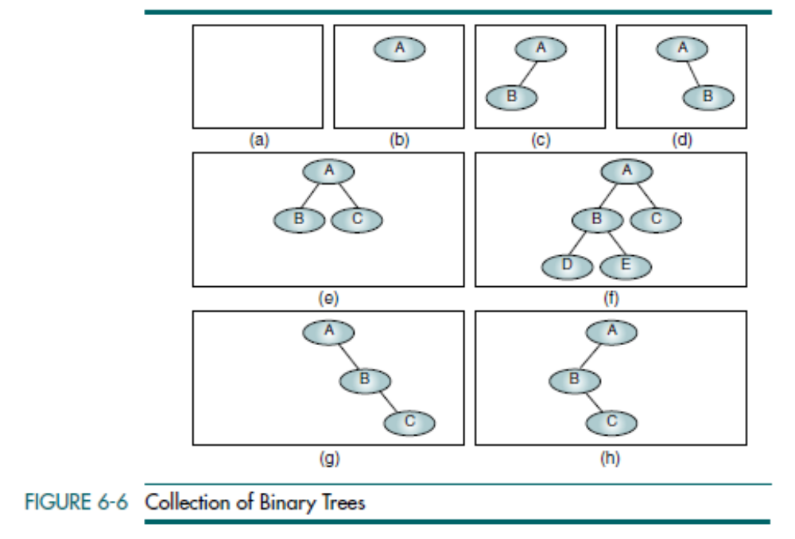
Null Tree is a tree with no nodes
Data Structures: A Pseudocode Approach with C

Slide 10

Properties of Binary Trees
Height of Binary Trees
Maximum Height
Given that we need to store N nodes in a binary tree, the maximum height,
Hmax, is
Minimum Height
Data Structures: A Pseudocode Approach with C

Slide 11
Minimum Number of Nodes
Maximum Number of Nodes
The balance factor of a binary tree is the difference in height between its left and right subtrees.
In a balanced binary tree, the height of its subtrees differs by no more than one (its balance factor is –1, 0, or +1), and its subtrees are also balanced.
Data Structures: A Pseudocode Approach with C

Slide 12
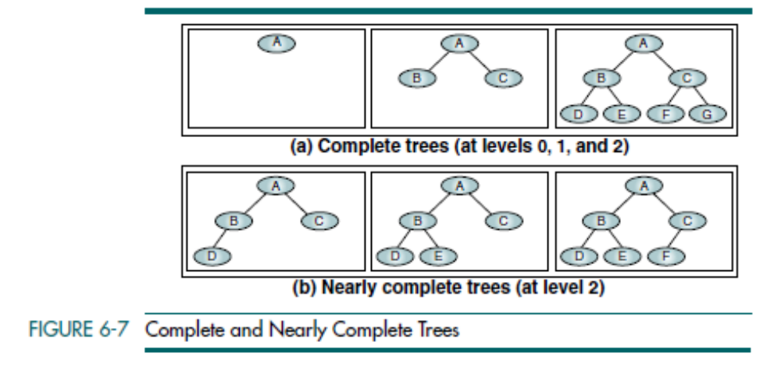
A Complete Tree has the maximum number of entries for its height (see formula Nmax in “Height of Binary Trees”). The maximum number is reached when the last level is full (see Figure 6-7). A tree is considered Nearly Complete if it has the
minimum height for its nodes (see formula Hmin) and all nodes in the last level are found on the left.
Data Structures: A Pseudocode Approach with C

Slide 13
Binary Tree Traversals
A binary tree traversal requires that each node of the tree be processed once and only once in a predetermined sequence. The two general approaches to the traversal sequence are depth first and breadth first.
In the depth-first traversal, the processing proceeds along a path from the root through one child to the most distant descendent of that first child before processing a second child. In other words, in the depth-first traversal, we process all of the descendants of a child before going on to the next child.
In a breadth-first traversal, the processing proceeds horizontally from the root to all of its children, then to its children’s children, and so forth until all nodes have been processed. In other words, in the breadth-first traversal, each level is completely processed before the next level is started.
Data Structures: A Pseudocode Approach with C

Slide 14
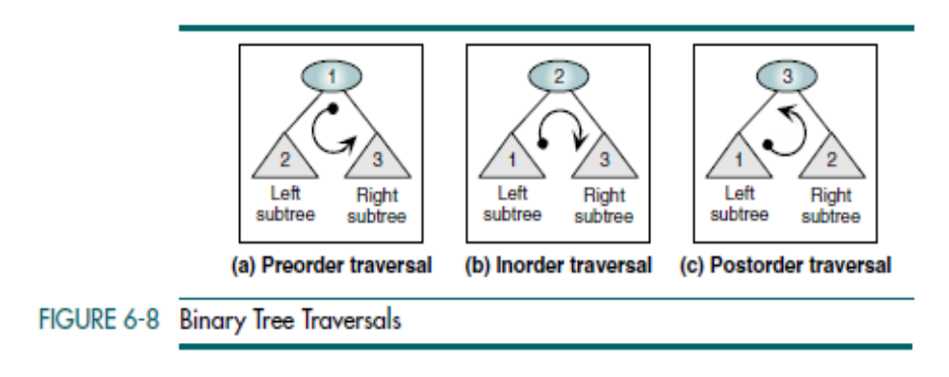
Depth-first Traversals
Given that a binary tree consists of a root, a left subtree, and a right subtree, we can define six different depth-first traversal sequences. Computer scientists have assigned three of these sequences standard names in the literature.
Data Structures: A Pseudocode Approach with C

Slide 15
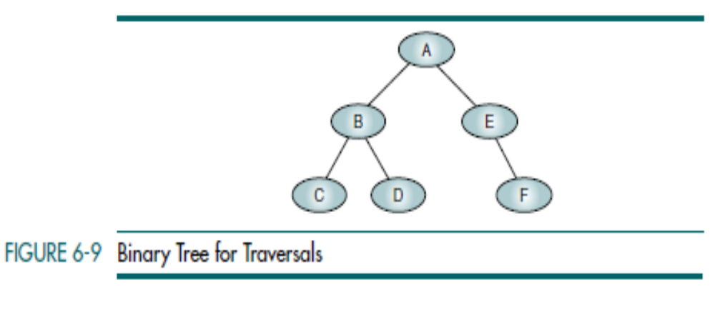
Data Structures: A Pseudocode Approach with C

Slide 16
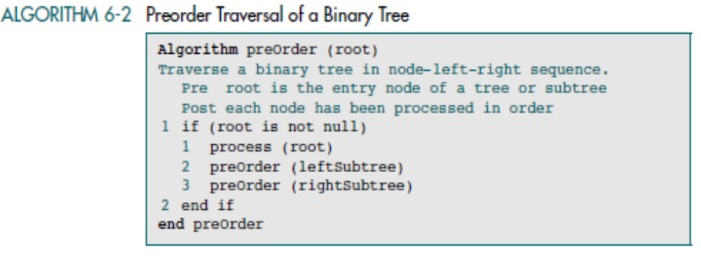
Preorder Traversal (NLR)
In the preorder traversal, the root node is processed first, followed by the left subtree and then the right subtree. It draws its name from the Latin prefix pre, which means to go before. Thus, the root goes before the subtrees.
Data Structures: A Pseudocode Approach with C

Slide 17
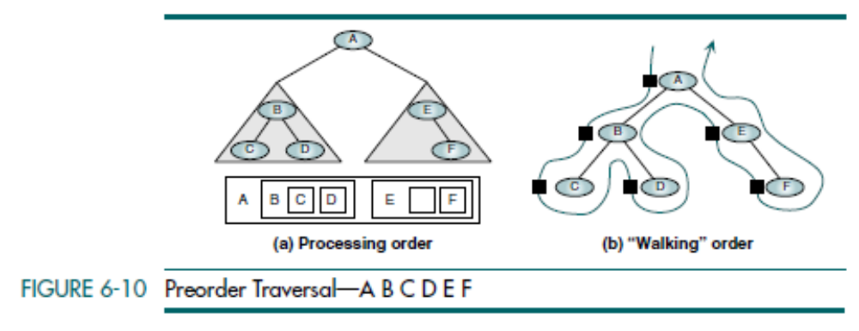
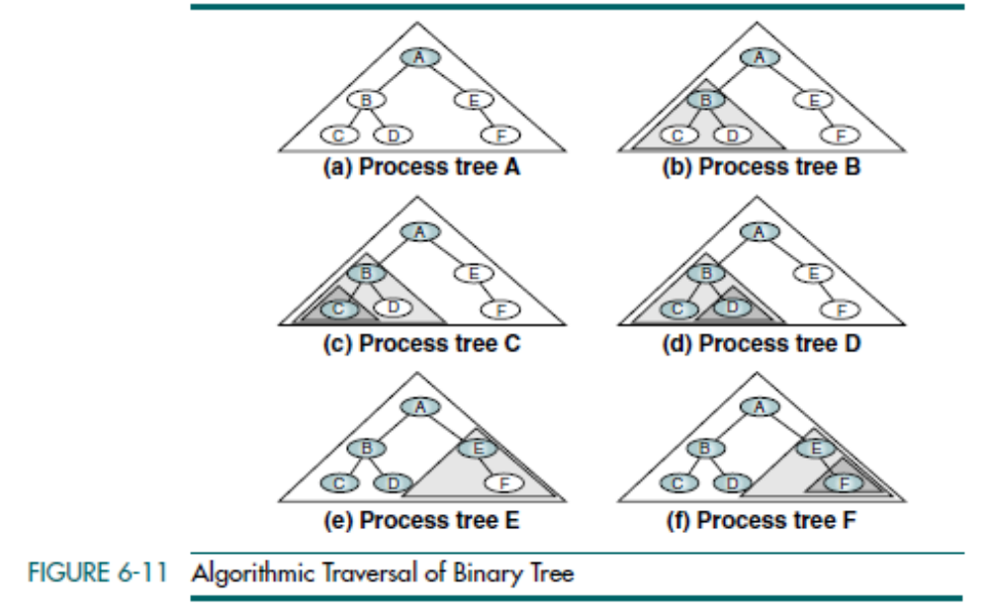
Data Structures: A Pseudocode Approach with C

Slide 18
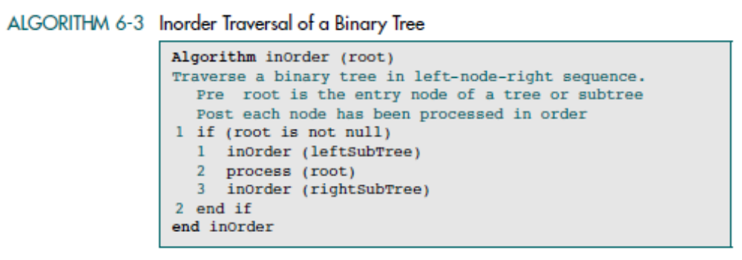
Inorder Traversal (LNR)
The inorder traversal processes the left subtree first, then the root, and finally the right subtree. The meaning of the prefix in is that the root is processed in between the subtrees.
Data Structures: A Pseudocode Approach with C

Slide 19
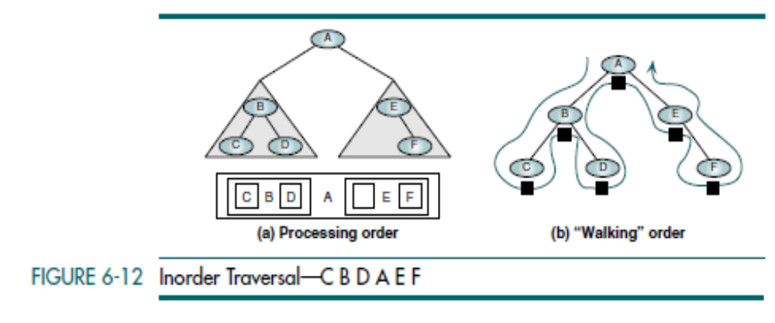
Data Structures: A Pseudocode Approach with C

Slide 20
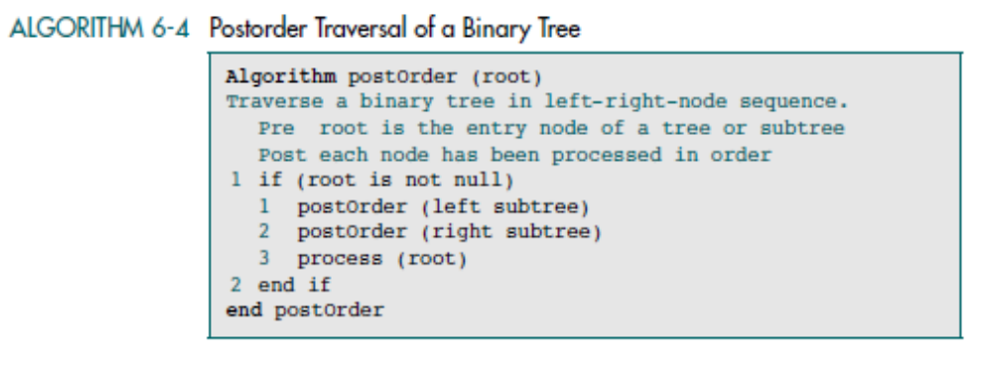
Postorder Traversal (LRN)
The last of the standard traversals is the postorder traversal. It processes the root node after (post) the left and right subtrees have been processed. It starts by locating the far-left leaf and processing it. It then processes its right sibling,
including its subtrees (if any). Finally, it processes the root node.
Data Structures: A Pseudocode Approach with C

Slide 21
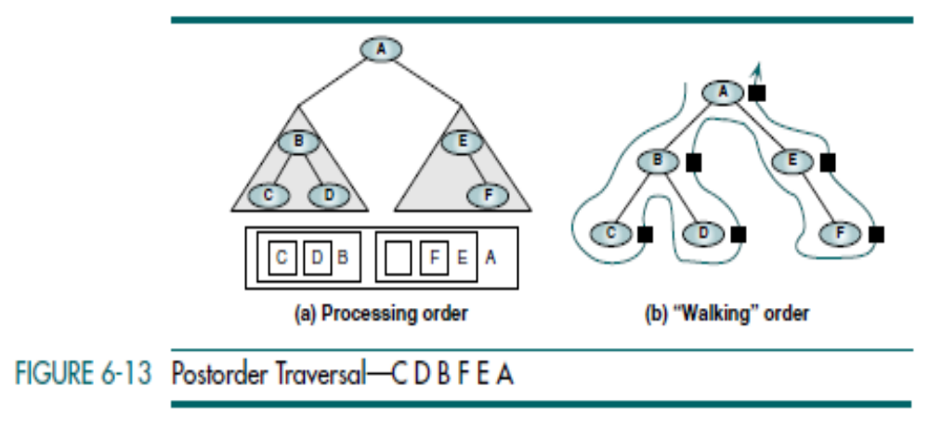
Data Structures: A Pseudocode Approach with C

Slide 22
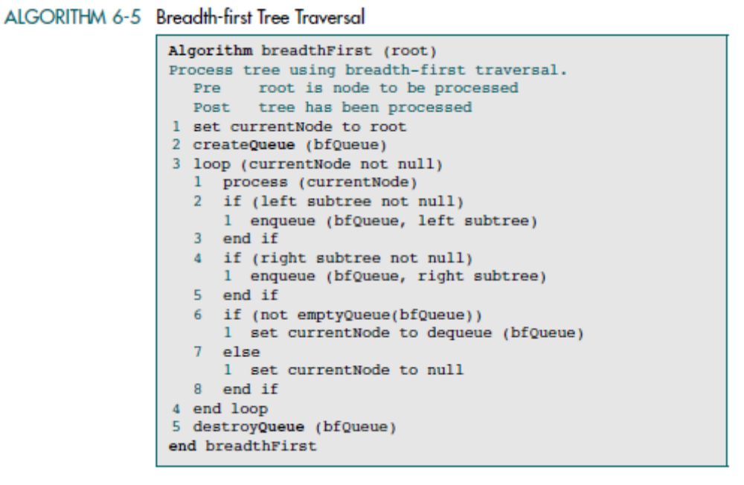
Breadth-first Traversals
In the breadth-first traversal of a binary tree, we process all of the children of a node before proceeding with the next level. In other words, given a root at level n, we process all nodes at level n before proceeding with the nodes at level n + 1. To traverse a tree in depth-first order, we used a stack. (Remember that recursion uses a stack.) To traverse a tree in breadth-first order, we use a queue.
Data Structures: A Pseudocode Approach with C

Slide 23
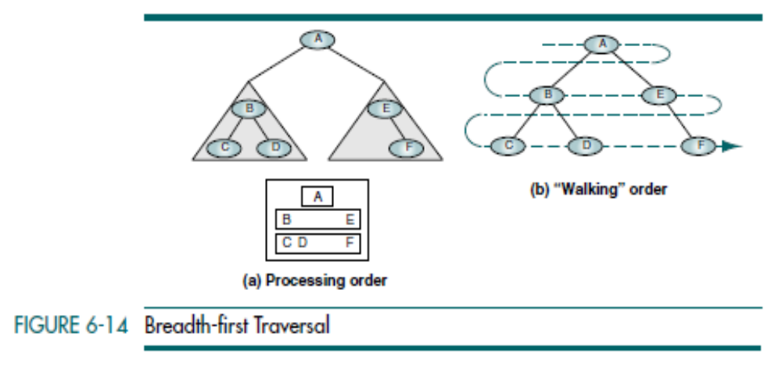
Data Structures: A Pseudocode Approach with C

Slide 24
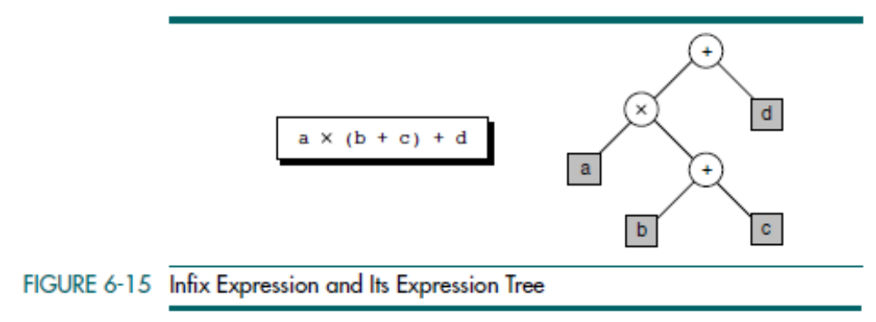
Expression Trees
One interesting application of binary trees is expression trees. An expression is a sequence of tokens that follow prescribed rules. A token may be either an operand or an operator. In this discussion we consider only binary arithmetic operators in the form operand–operator–operand. The standard arithmetic operators are +, -, *, and /.
An expression tree is a binary tree with the following properties:
• Each leaf is an operand.
• The root and internal nodes are operators.
• Subtrees are subexpressions, with the root being an operator.
Data Structures: A Pseudocode Approach with C

Slide 25
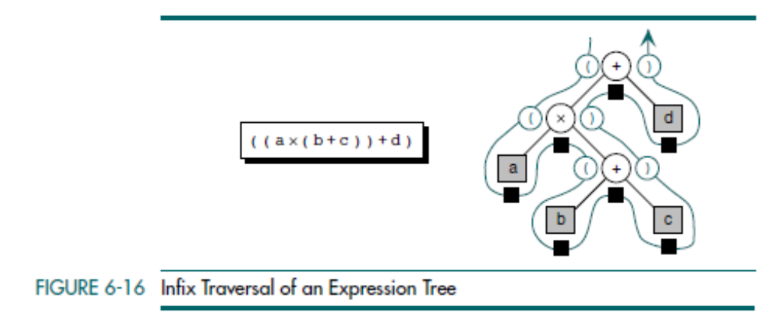
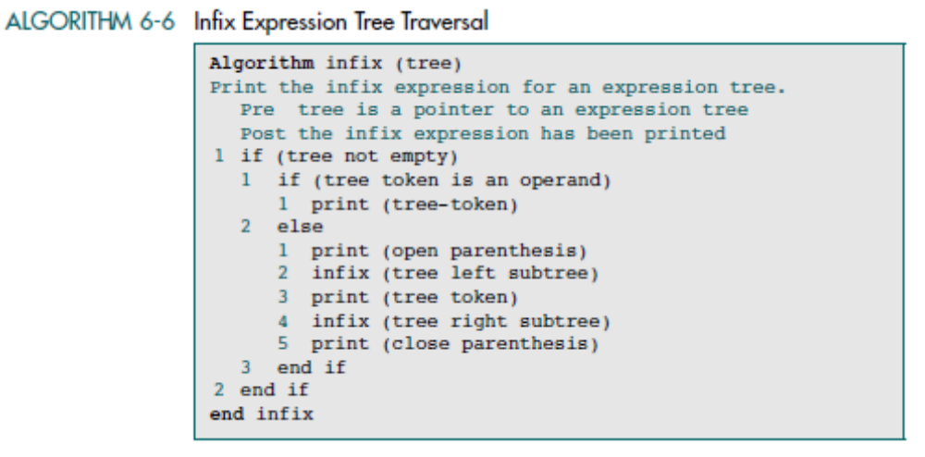
Data Structures: A Pseudocode Approach with C

Slide 26
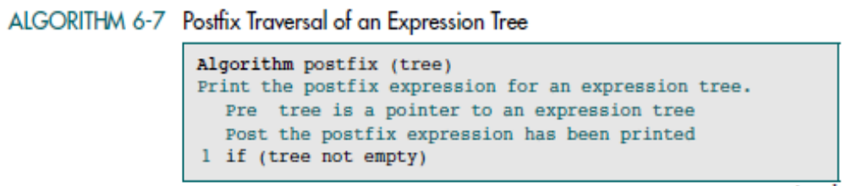
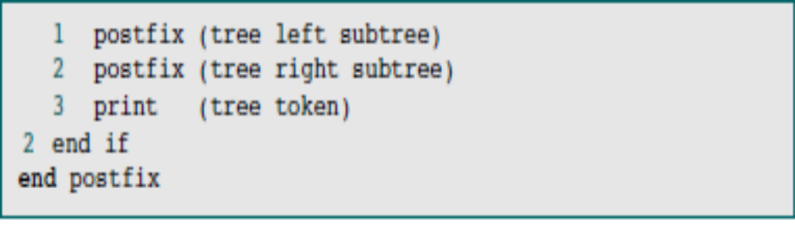
Data Structures: A Pseudocode Approach with C

Slide 27
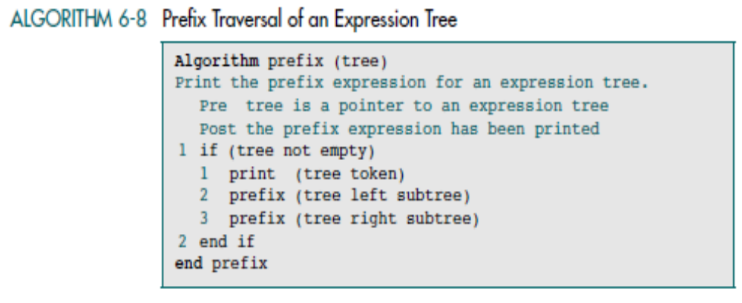
Data Structures: A Pseudocode Approach with C

Slide 28
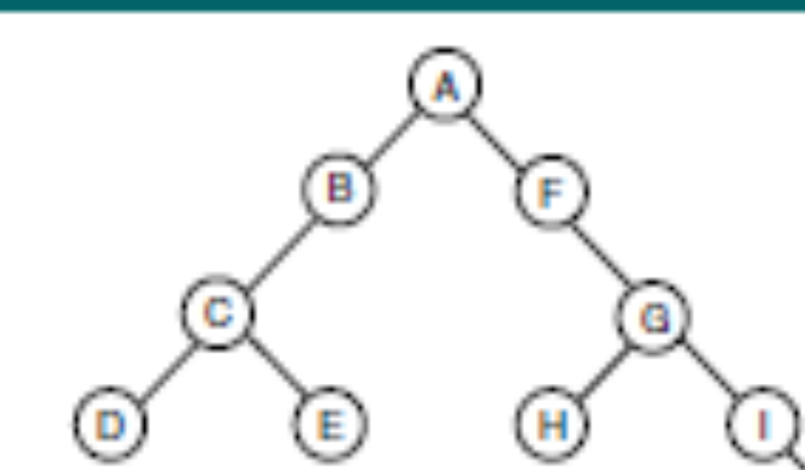
Data Structures: A Pseudocode Approach with C

Slide 29
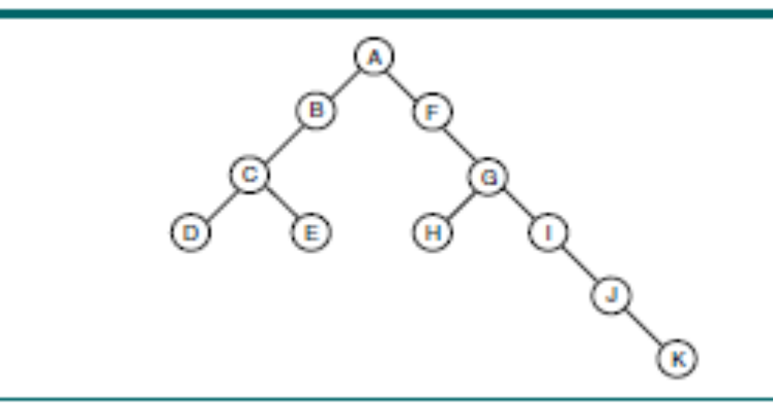
Data Structures: A Pseudocode Approach with C

Slide 30
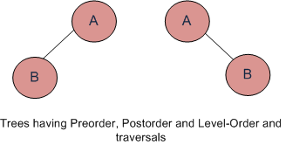
If you are given two traversal sequences, can you construct the binary tree?
It depends on what traversals are given. If one of the traversal methods is Inorder then the tree can be constructed, otherwise not.
Therefore, following combination can uniquely identify a tree.
Inorder and Preorder.
Inorder and Postorder.
Inorder and Level-order.
And following do not.
Postorder and Preorder.
Preorder and Level-order.
Postorder and Level-order.
For example, Preorder, Level-order and Postorder traversals are same for the trees given in above diagram.
Preorder Traversal = AB
Postorder Traversal = BA
Level-Order Traversal = AB
So, even if three of them (Pre, Post and Level) are given, the tree can not be constructed.
Data Structures: A Pseudocode Approach with C

Slide 31
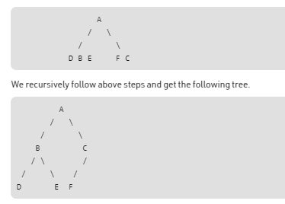
Construct Tree from given Inorder and Preorder traversals
Let us consider the below traversals:
Inorder sequence: D B E A F C
Preorder sequence: A B D E C F
In a Preorder sequence, leftmost element is the root of the tree. So we know ‘A’ is root for given sequences. By searching ‘A’ in Inorder sequence, we can find out all elements on left side of ‘A’ are in left subtree and elements on right are in right subtree. So we know below structure now.

Slide 32
BINARY SEARCH TREE (BST)
Data Structures: A Pseudocode Approach with C

Slide 33
In the design of the linear list structure, we had two choices: an array or a linked list.
The array structure provides a very efficient search algorithm but its insertion and deletion algorithms are very inefficient.
On the other hand, the linked list structure provides efficient insertion and deletion, but its search algorithm is very inefficient.
What we need is a structure that provides an efficient search algorithm and at the same time efficient insert and delete algorithms.
The binary search tree and the AVL tree provide that structure
Data Structures: A Pseudocode Approach with C

Slide 34
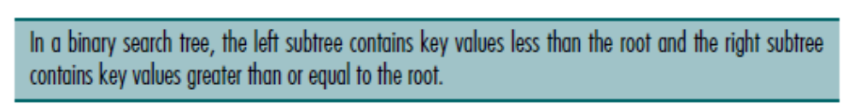
BINARY SEARCH TREE (BST)
A binary search tree (BST) is a binary tree with the following properties:
• All items in the left subtree are less than the root.
• All items in the right subtree are greater than or equal to the root.
• Each subtree is itself a binary search tree.
Data Structures: A Pseudocode Approach with C

Slide 35
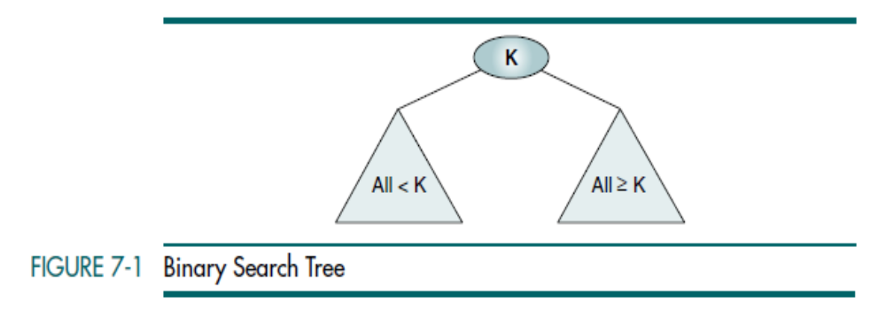
Data Structures: A Pseudocode Approach with C

Slide 36
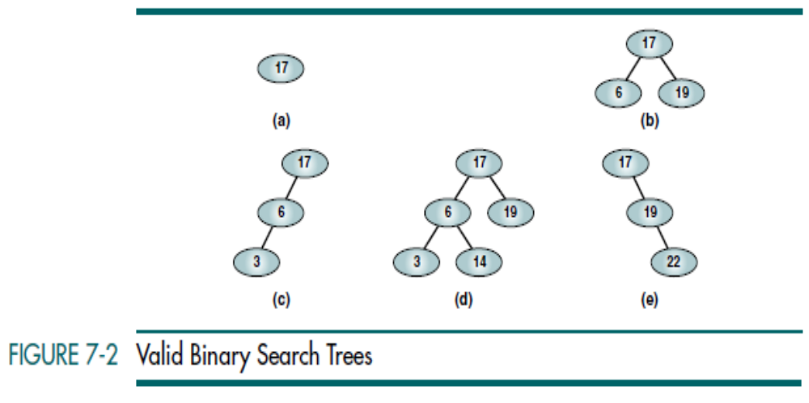
Data Structures: A Pseudocode Approach with C

Slide 37
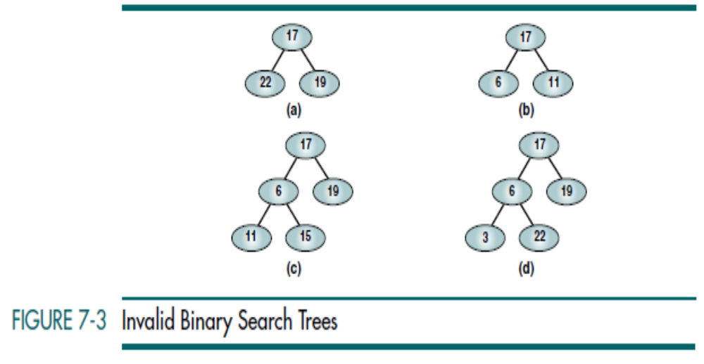
Data Structures: A Pseudocode Approach with C

Slide 38
BST Operations
Traversals
Searches
  Find the Smallest Node
  Find the Largest Node
  BST Search
Insertion
Deletion
Data Structures: A Pseudocode Approach with C

Slide 39
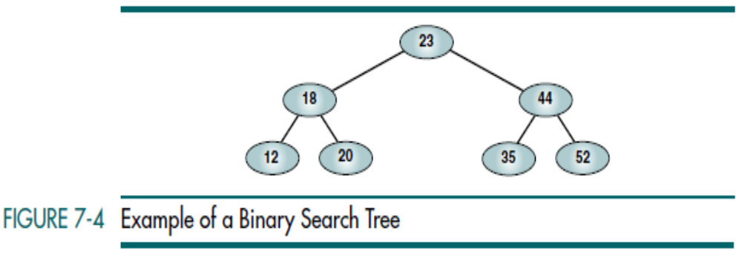



Preorder BST Traversal
Postorder BST Traversal
Inorder BST Traversal
Data Structures: A Pseudocode Approach with C

Slide 40
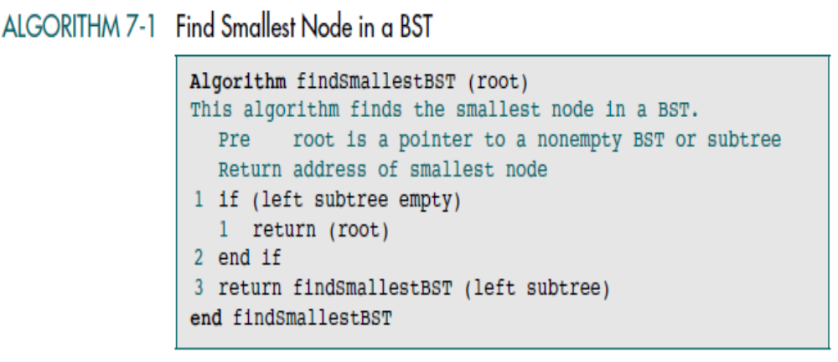
Data Structures: A Pseudocode Approach with C

Slide 41
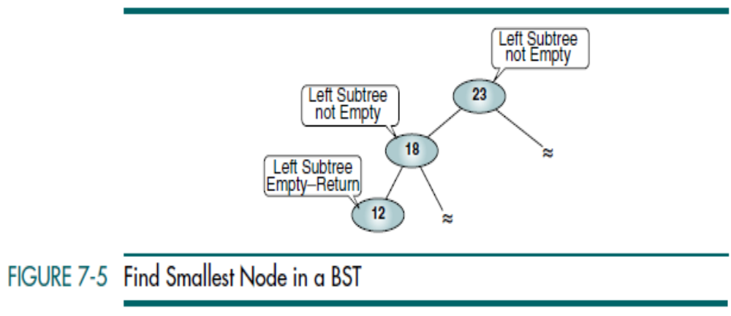
Data Structures: A Pseudocode Approach with C

Slide 42
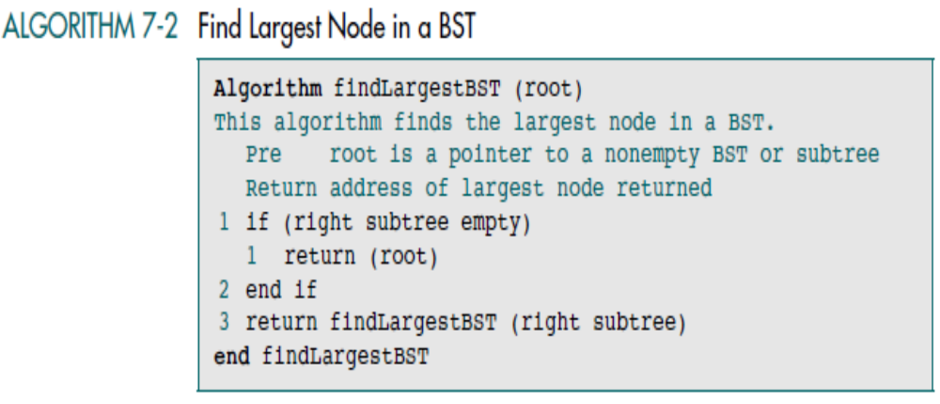
Data Structures: A Pseudocode Approach with C

Slide 43
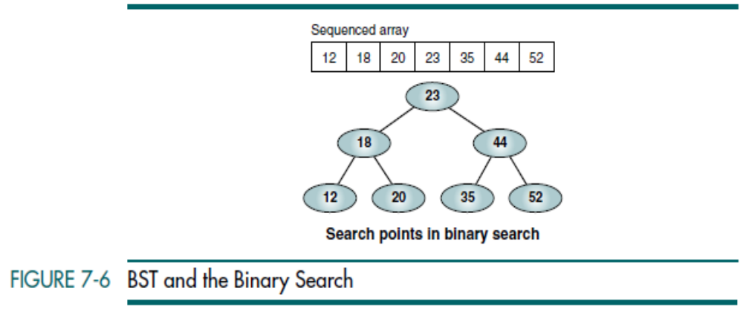
Data Structures: A Pseudocode Approach with C

Slide 44
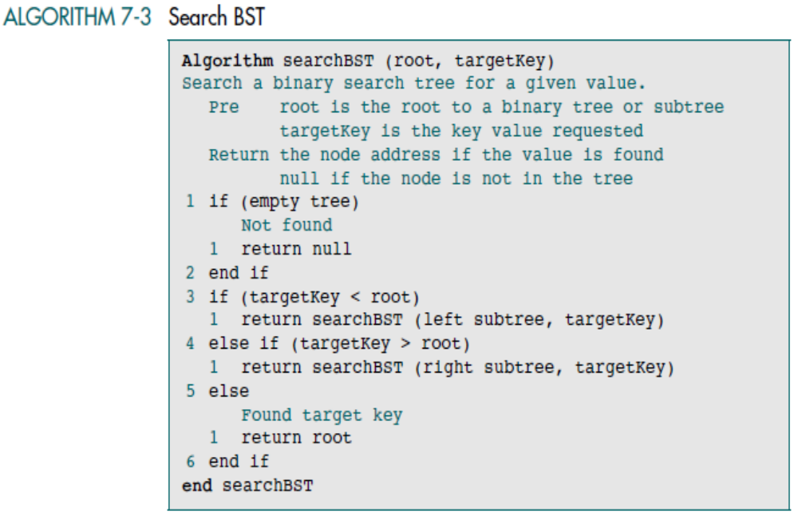
Data Structures: A Pseudocode Approach with C

Slide 45
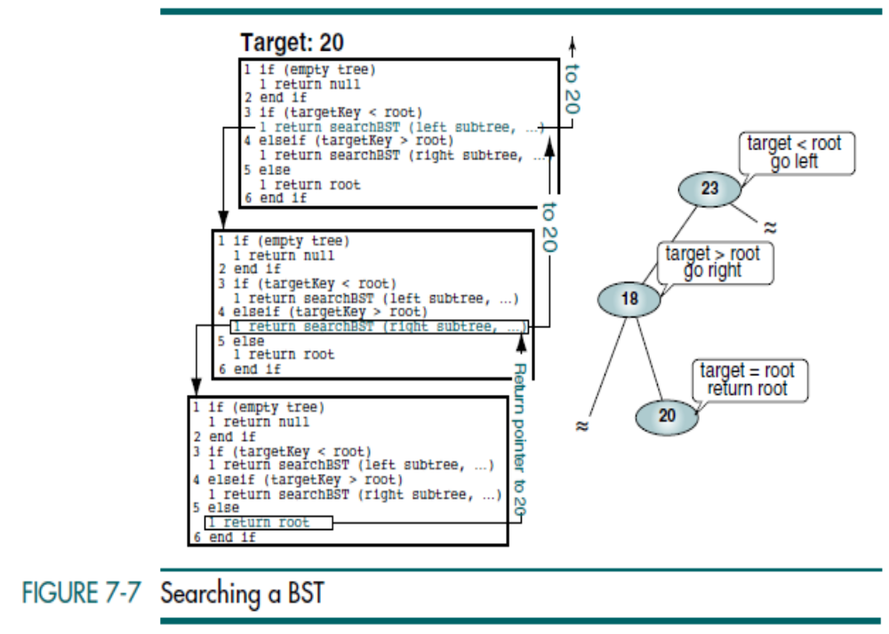
Data Structures: A Pseudocode Approach with C

Slide 46
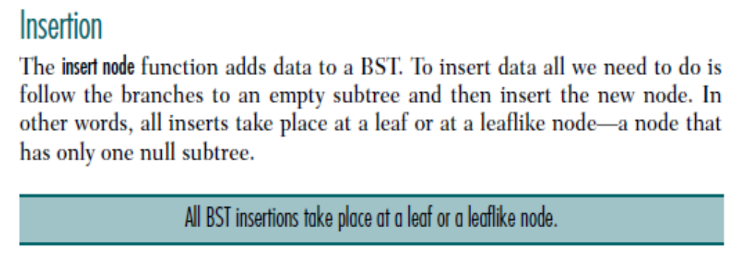
Data Structures: A Pseudocode Approach with C

Slide 47
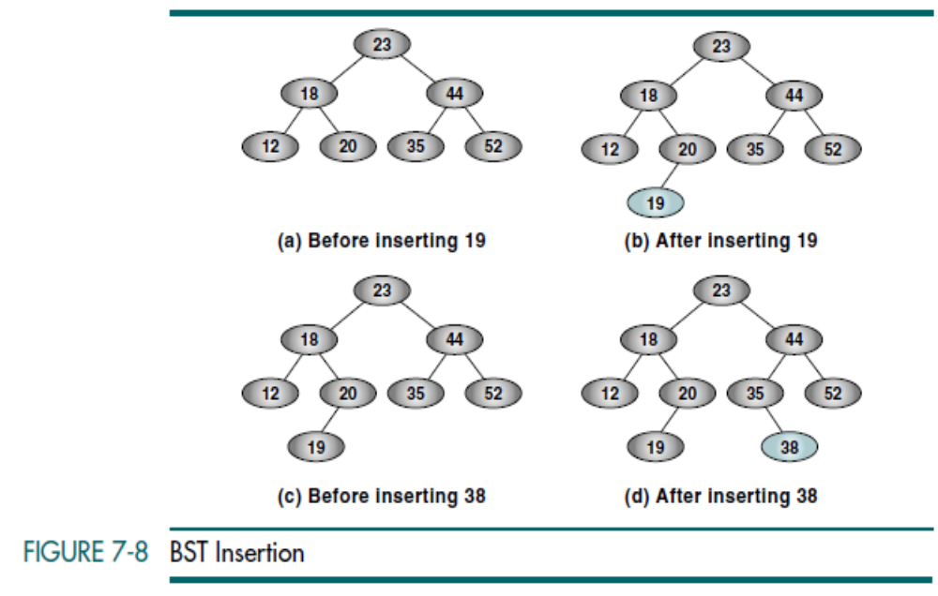
Data Structures: A Pseudocode Approach with C

Slide 48
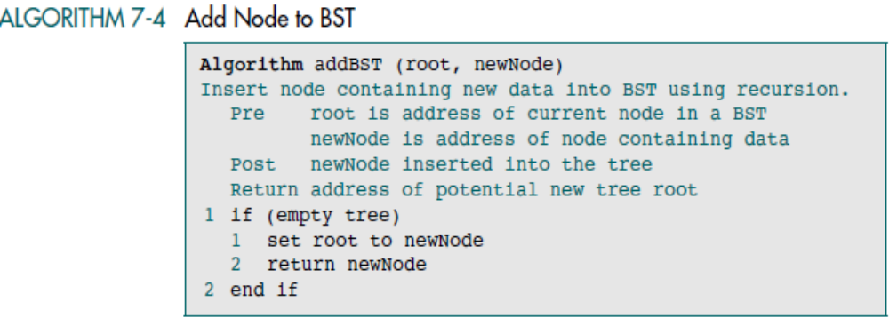
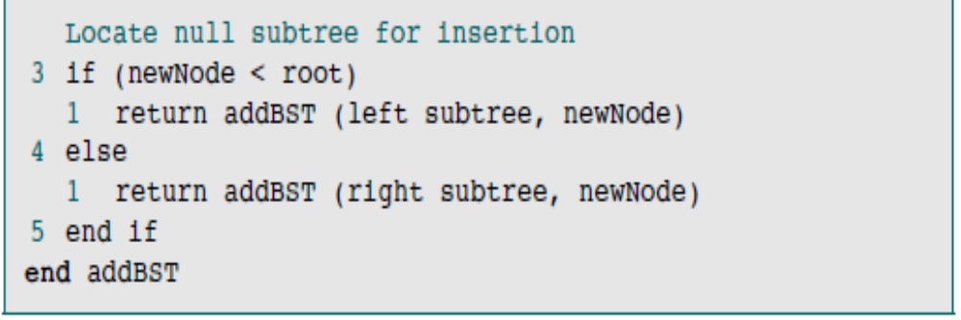
Data Structures: A Pseudocode Approach with C

Slide 49
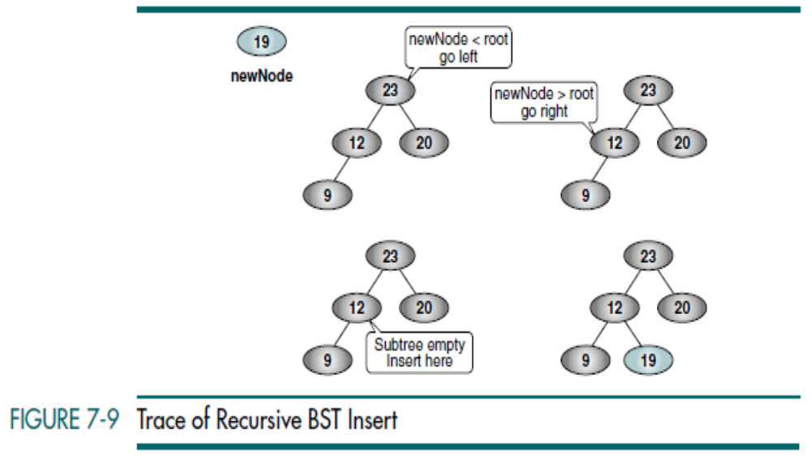
Data Structures: A Pseudocode Approach with C

Slide 50
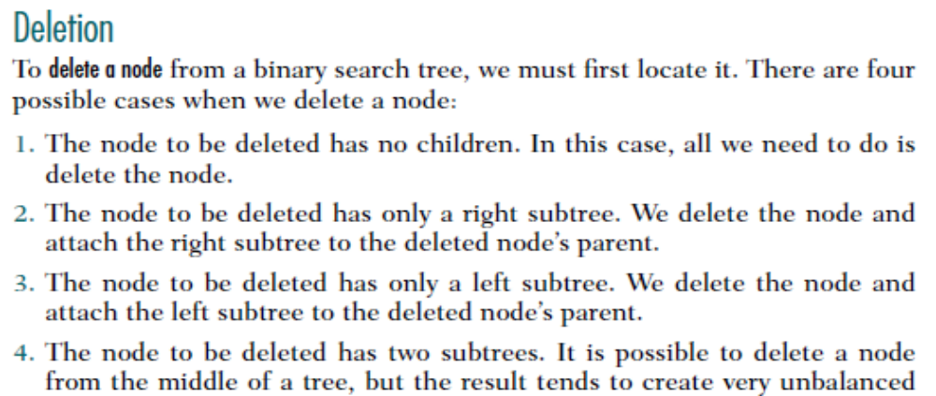
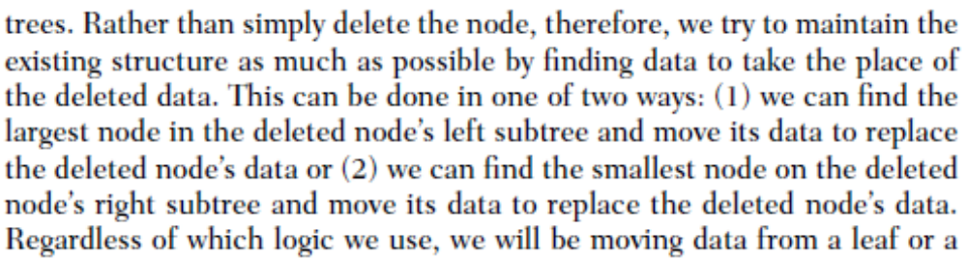
Data Structures: A Pseudocode Approach with C

Slide 51
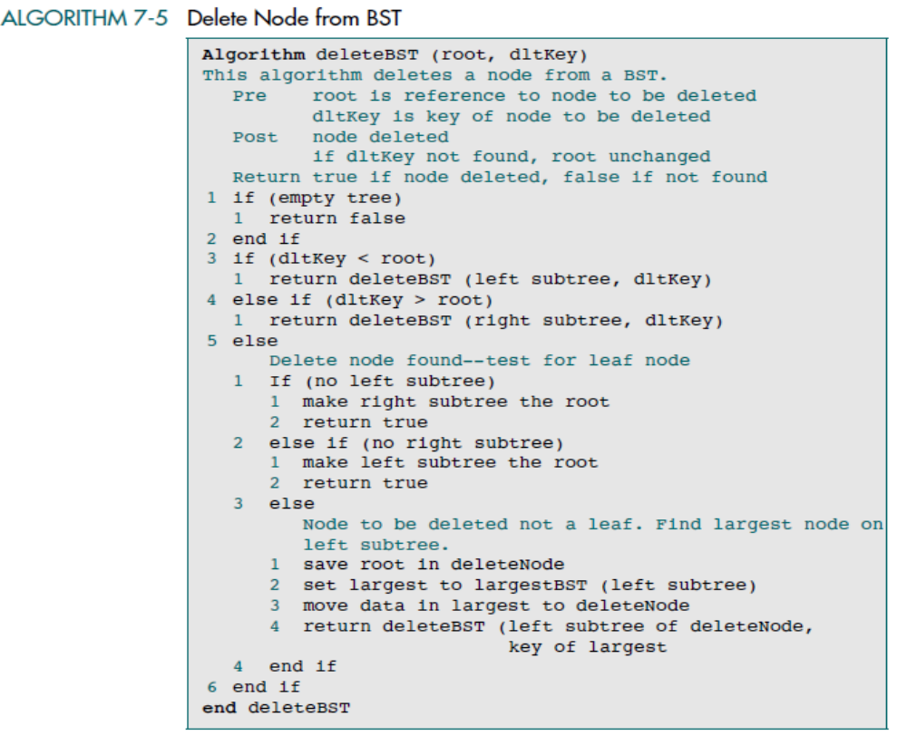
Data Structures: A Pseudocode Approach with C

Slide 52
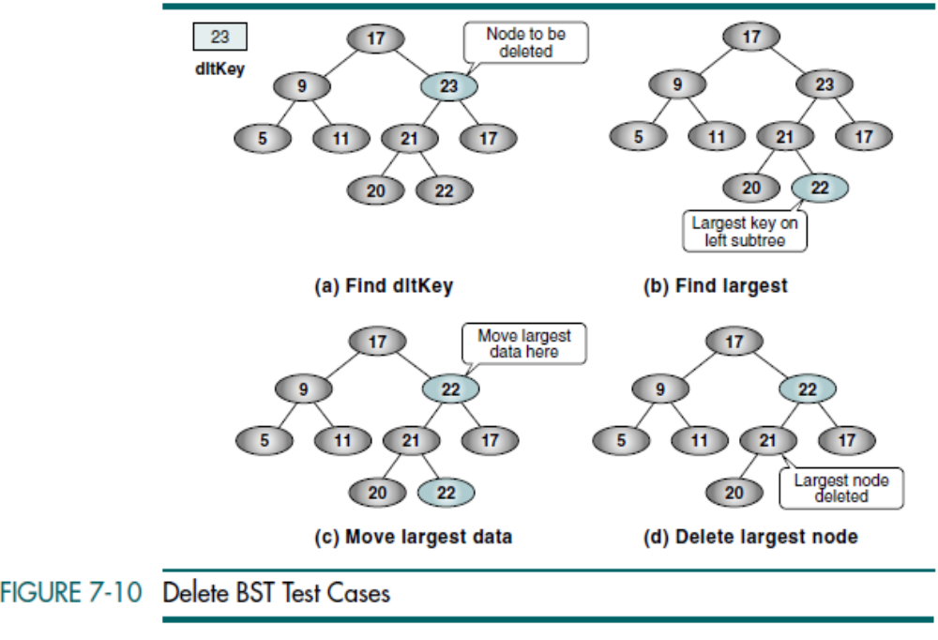
Data Structures: A Pseudocode Approach with C

Slide 53
Integer Application
The BST tree integer application reads integers from
the keyboard and inserts them into the BST.
Data Structures: A Pseudocode Approach with C

Slide 54
AVL Tree
In 1962, two Russian mathematicians, G. M. Adelson-Velskii and E. M. Landis, created the balanced binary tree structure that is named after them—the AVL tree. An AVL tree is a search tree in which the heights of the subtrees differ by no more than 1. It is thus a balanced binary tree.
Data Structures: A Pseudocode Approach with C

Slide 55
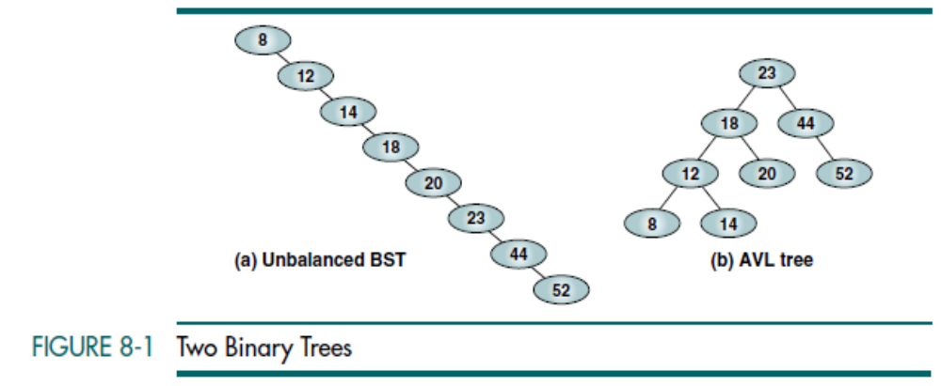
Consider the tree in Figure 8-1(a), it takes two tests to locate 12. It takes three tests to locate 14. It takes eight tests to locate 52. In other words, the search effort for this particular binary search tree is O(n).
Now consider the tree in Figure 8-1(b), locating nodes 8 and 14 requires four tests. Locating nodes 20 and 52 requires three tests. In other words, the maximum search effort for this tree is either three or four. Its search effort is O(log n).

Slide 56
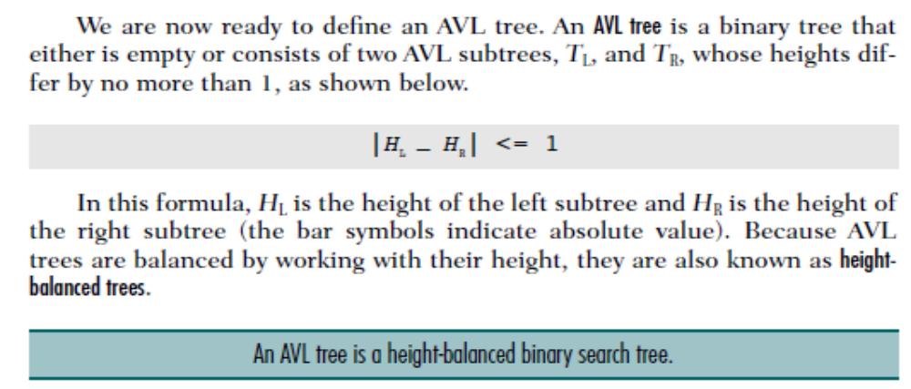
AVL Tree Balance Factor
The balance factor for any node in an AVL tree must be +1, 0, or –1 LH for left high (+1) to indicate that the left subtree is higher than the right subtree, EH for even high (0) to indicate that the subtrees are the same height, and RH for right high (–1) to indicate that the left subtree is shorter than the right subtree.
Data Structures: A Pseudocode Approach with C

Slide 57
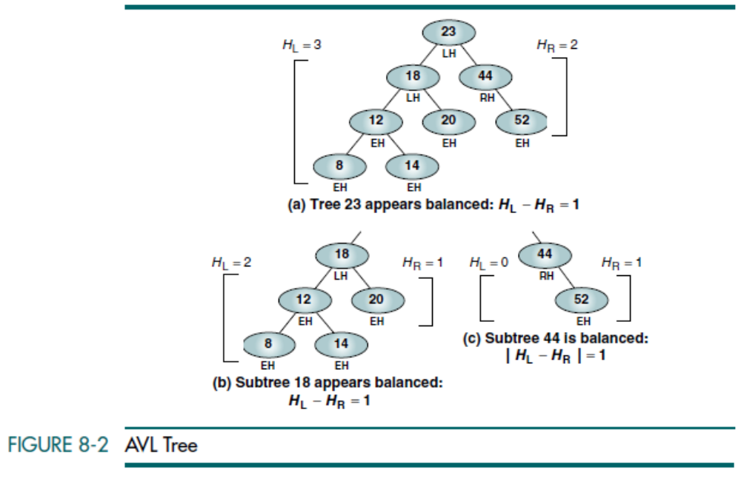
Data Structures: A Pseudocode Approach with C

Slide 58

Data Structures: A Pseudocode Approach with C

Slide 59

Data Structures: A Pseudocode Approach with C

Slide 60

Data Structures: A Pseudocode Approach with C

Slide 61

Data Structures: A Pseudocode Approach with C

Slide 62

Data Structures: A Pseudocode Approach with C

Slide 63

Data Structures: A Pseudocode Approach with C

Slide 64

Data Structures: A Pseudocode Approach with C

